Slide 1

Deep Learning-based Job Placement in Distributed Machine Learning Clusters
Yixin Bao, Yanghua Peng, Chuan Wu
The University of Hong Kong

Slide 2
Distributed Machine Learning (ML) Systems
Increasing deep learning workloads in production clusters

Slide 3



Parameter Server Architecture
PS
gradients
gradients
Worker
parameters
parameters

Slide 4
Motivation
How to efficiently place different ML jobs onto servers
High resource efficiency
Training throughput
Network IO
CPU Cache
Buses
Different levels of interference
CPU intensive -- CTC
Disk I/O intensive -- AlexNet
High network bandwidth consumption -- VGG-16
Notes:
CTC, sentence classification
AlexNet, image classification VGG-16, image classification
Share cluster, interference appear, degrade training performance significantly
Compete network for data transmission.
when the GPU cards on a server are allocated to different ML jobs, the PCIe bus is shared when the jobs shuffle data between CPU and GPU; the QPI bus is shared when two allocated GPUs are not attached to the same CPU in the non-uniform memory access architecture.

Slide 5
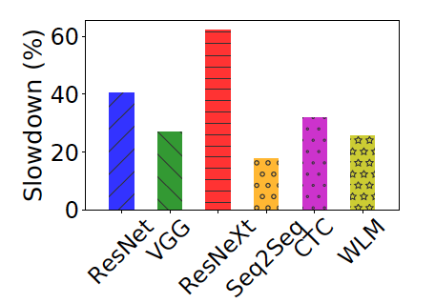
Bin Packing vs. Standalone Execution
Interference study 1
Average 33% slowdown compared to standalone
Notes:
Introduce what two policies are
Run 6 jobs together under bp and salone policy
Feasible when # of wk/ps is small
ResNet-50 image classification ImageNet VGG-16 image classification ImageNet ResNeXt-110 image classification CIFAR10 Seq2Seq machine translation WMT17 CTC sentence classification mr WLM language modeling PTB

Slide 6
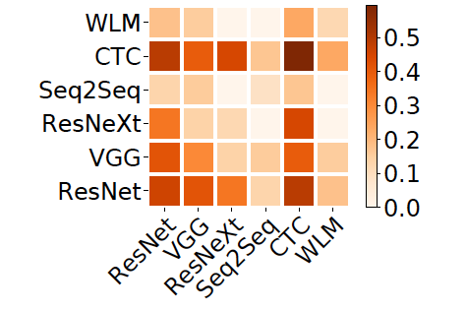
Pair-wise Interference Level
Interference study 2
ResNeXt and WLM/Seq2Seq are less affected when trained together
Co-locating models incur different interference

Slide 7
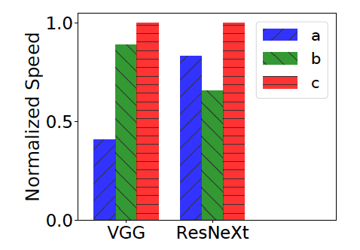
Placement under Representative Policies
Interference study 3
a: load balancing
b: multi-resource bin packing
c: standalone execution
Existing schemes are not good enough
Performance interference is hard to identify and model
Avoid cross-machine communication
But lead to more severe interference
Notes:
Sometimes LB better, sometimes BP better
achieve high resource utilization and training speed at the same time

Slide 8
Existing Approaches
Borg, Mesos, etc.
Interference-oblivious
Co-located ML jobs may interfere with each other
Build an explicit interference model
Require detailed application profiling
Require expert knowledge to design the model
What if the workload type or hardware configuration changes?
Design a deep reinforcement learning-driven ML cluster scheduler to place training jobs
Notes:
General cloud scheduler
Tune hyper-parameters carefully, human labor

Slide 9
Our Approach
Job placement policy that embraces interference
Do not rely on detailed analytical performance modeling
Encode workload interference implicitly in a neural network
Raw Cluster and Job State
Neural Network
Job Placement Decisions
Environment
Improve by Feedback
Notes:
Typical learning process of RL

Slide 10
Challenges in Applying DRL in Job Placement
Large action space
Combinatorial optimization problem
Re-design the action
Simulate interaction with the environment
Difficult to collect enough traces
Using another NN for reward modeling
Notes:
Feasible solutions is exponential
Hard for NN to converge if NN is of exp-ly large size
Improve DRL model through the feedback. We can not foresee what kind of action RL will make during the training process

Slide 11
Harmony: System Overview
Online Inference
Deep Reinforcement Learning
Submitted Jobs
Observe State Change
Synthetic Trace
State
Neural Network
Placement Policy
DRL Model
Reward
Reward Model
Supervised Learning
Job
Placement
Historical Trace
Neural Network
Reward Prediction
Collect Trace
Notes:
Reward helps us to evaluate whether the decision is good or not

Slide 12
Harmony: System Overview
Online Inference
Deep Reinforcement Learning
Submitted Jobs
Observe State Change
Synthetic Trace
State
Neural Network
Placement Policy
DRL Model
Reward
Reward Model
Supervised Learning
Job
Placement
Historical Trace
Neural Network
Reward Prediction
Collect Trace

Slide 13
DRL Framework - State Space
the ML models trained by the jobs
worker/parameter server resource demands of the jobs
available amount of resources on the servers
the placement of concurrent jobs on the servers
the number of workers/parameter servers allocated
Notes:
Sensitivity to interference is different

Slide 14
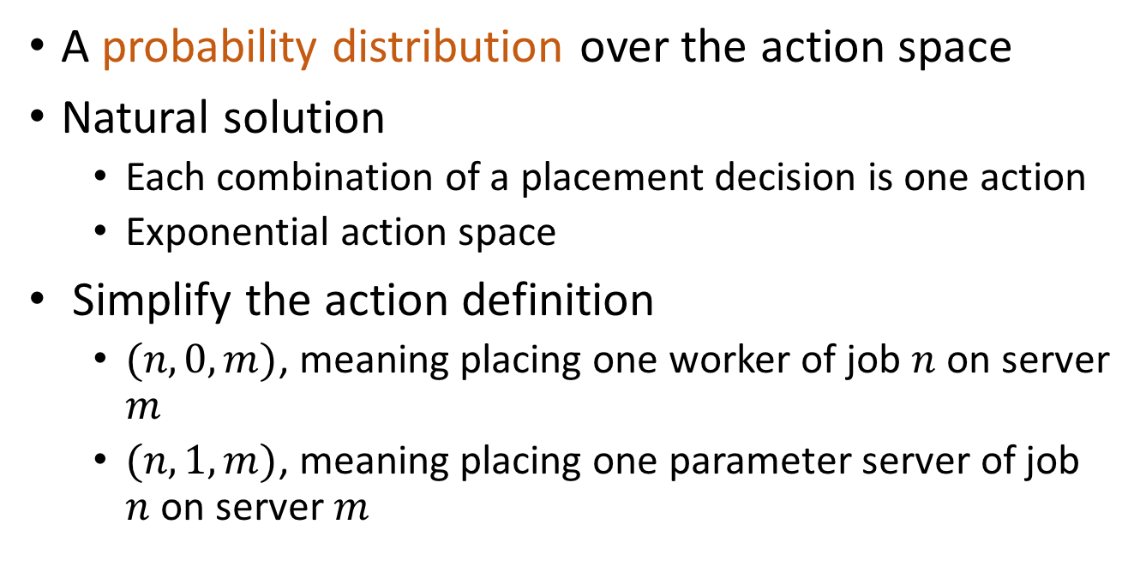
DRL Framework - Action Space
A probability distribution over the action space
Natural solution
Each combination of a placement decision is one action
Exponential action space
Simplify the action definition
$(n,0,m)$, meaning placing one worker of job $n$ on server $m$
$(n,1,m)$, meaning placing one parameter server of job $n$ on server $m$
Polynomial action space
Notes:
triple

Slide 15
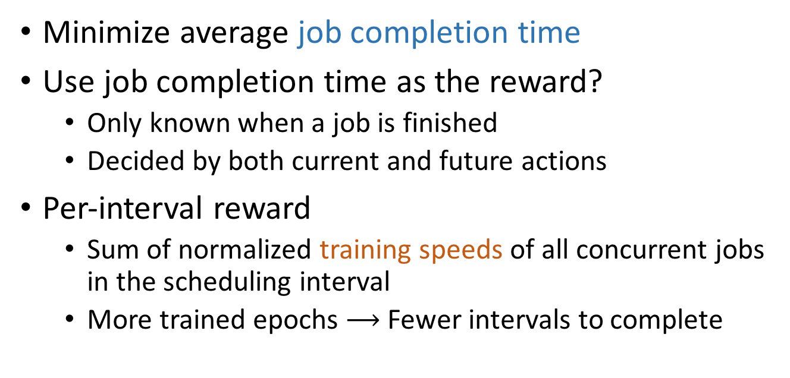
DRL Framework - Reward
Minimize average job completion time
Use job completion time as the reward?
Only known when a job is finished
Decided by both current and future actions
Per-interval reward
Sum of normalized training speeds of all concurrent jobs in the scheduling interval
More trained epochs $⟶$ Fewer intervals to complete
Notes:
Appear hundreds of steps later, little guidance to the decisions made earlier
If only one reward after sequence of actions. Differentiate which decision in which step is better
Consistent, Collect more reward samples, expedite training process

Slide 16
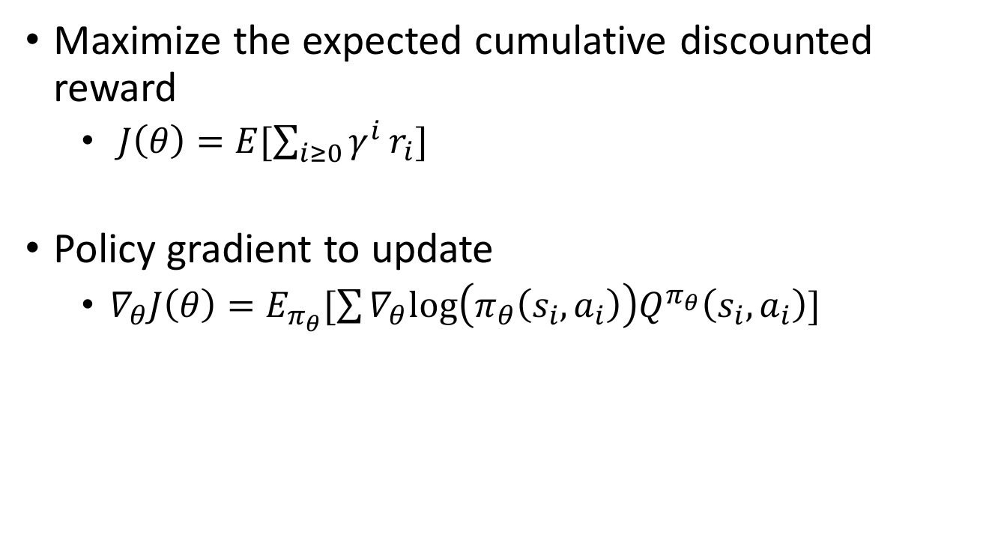
DRL Model Training
Maximize the expected cumulative discounted reward
$J\left(θ\right)=E[\sum_{i≥0}{γ^{i}}r_{i}]$
Policy gradient to update
$∇_{θ}J\left(θ\right)=E_{π_{θ}}[\sum{∇_{θ}log\left(π_{θ}\left(s_{i},a_{i}\right)\right)Q^{π_{θ}}\left(s_{i},a_{i}\right)}]$
Quality of the action
Policy
Increase the probabilities of selecting actions with higher quality

Slide 17
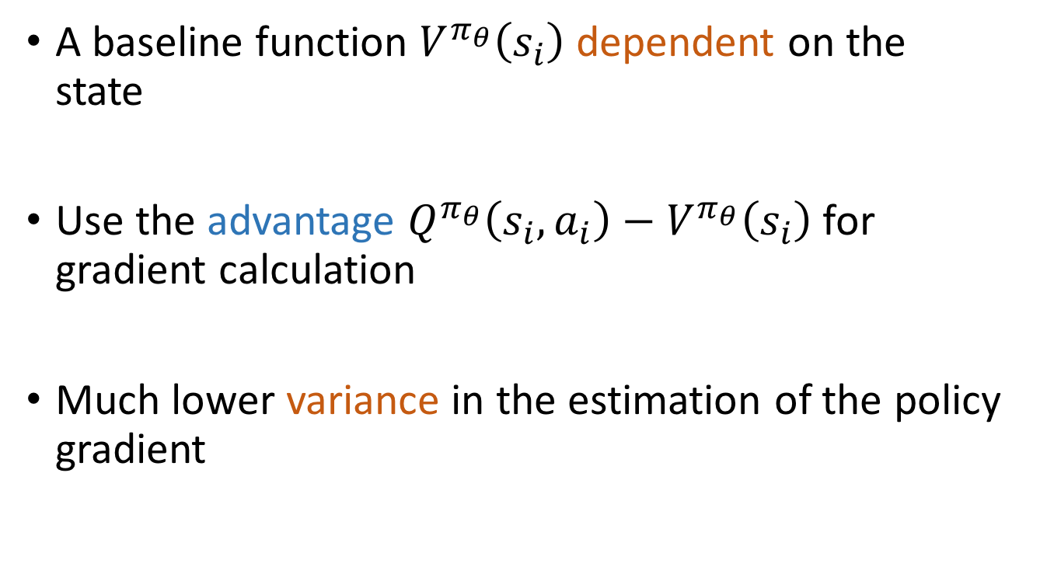
Training Techniques - Actor-critic
A baseline function $V^{π_{θ}}\left(s_{i}\right)$ dependent on the state
Use the advantage $Q^{π_{θ}}\left(s_{i},a_{i}\right)−V^{π_{θ}}\left(s_{i}\right)$ for gradient calculation
Much lower variance in the estimation of the policy gradient
Estimated by a value network
Notes:
Make training process more stable

Slide 18
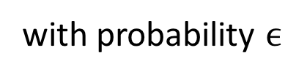
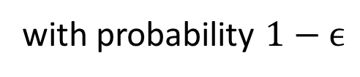
Training Techniques - Exploration
Ensure that the action space is adequately explored
Job-aware exploration
Action produced by NN
with probability $1−ϵ$
Randomly choose multi-resource bin packing or load balancing policies
with probability $ϵ$
Notes:
To make DRL converge to a good policy.
Letting DRL model do trial-and-error on its own is not enough due to hardness of problem
to provide better guidance
Resource utilization and workload interference

Slide 19
Harmony: System Overview
Online Inference
Deep Reinforcement Learning
Submitted Jobs
Observe State Change
Synthetic Trace
State
Neural Network
Placement Policy
DRL Model
Reward
Reward Model
Supervised Learning
Job
Placement
Historical Trace
Neural Network
Reward Prediction
Collect Trace
Notes:
Designed to train reward prediction model

Slide 20
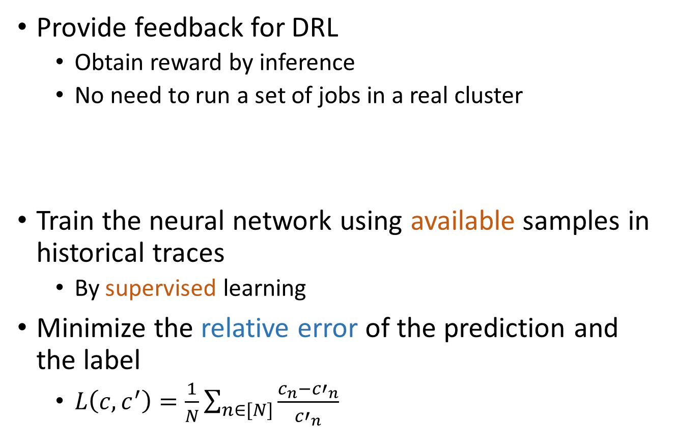
Reward Prediction Model
Provide feedback for DRL
Obtain reward by inference
No need to run a set of jobs in a real cluster
Train the neural network using available samples in historical traces
By supervised learning
Minimize the relative error of the prediction and the label
$L\left(c,c^{′}\right)=\frac{1}{N}\sum_{n∈[N]}{\frac{c_{n}−{c′}_{n}}{{c′}_{n}}}$
Job and Cluster State
Neural Network
Training Speed of Each Job
Notes:
Less error, closer to label from historical trace

Slide 21
Performance Evaluation
Implemented by TensorFlow
Adam optimizer
Workloads
Jobs are submitted in a uniform random manner
Model | Application domain | Dataset
ResNet-50 | Image classification | ImageNet
VGG-16 | Image classification | ImageNet
ResNeXt-110 | Image classification | CIFAR10
Seq2Seq | Machine translation | WTM17
CTC | Sentence classification | mr
WLM | Language modeling | PTB
Notes:
with 3 jobs per interval on average

Slide 22
Baselines
Load Balancing (LB)
Tetris
Least Interference First (LIF-Line, LIF-Quad)
Assign worker/parameter server to the server with the least load
Multi-resource bin packing to avoid resource fragmentation
Build a linear or non-linear interference model
Task slowdown is a function of CPU and bandwidth usage
Notes:
analytical interference model
select a machine with minimum interference greedily

Slide 23
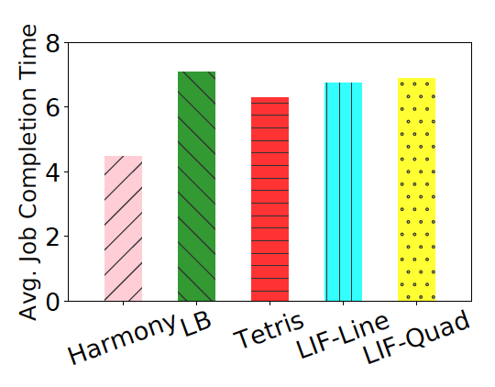
Comparison with Representative Placement Policy
23% improvement in job completion time

Slide 24
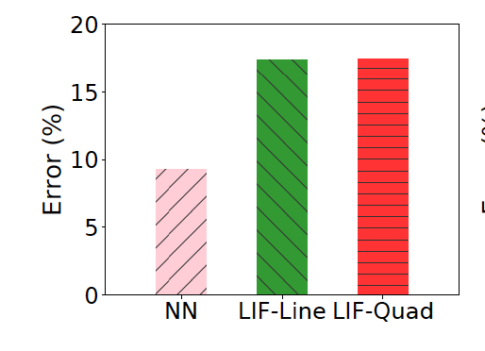
Comparison with Interference Model
10% training speed prediction error
Notes:
show performance of reward model and cmp prediction error

Slide 25
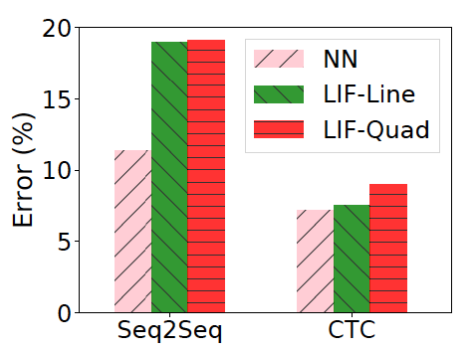
Comparison with Interference Model
Both CPU and GPU
CPU intensive

Slide 26
Concluding Remarks
Propose a deep learning-driven ML cluster scheduler for ML job placement
Big potential on improving resource efficiency in ML clusters
Future Work
Enable dynamic resource scaling
Perform fault tolerant job placement

Slide 27
Questions? Thank you!

